Slide 1
Azure Site Recovery (ASR) Setup

Slide 2
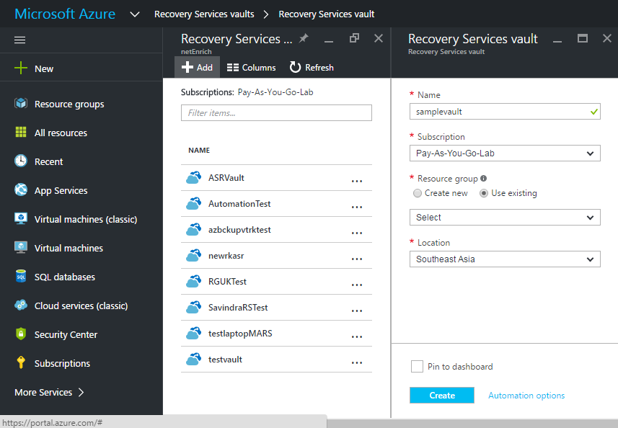
Create Azure Recovery Services Vault

Slide 3
Replicate VMware virtual machines and
physical machines to Azure

Slide 4
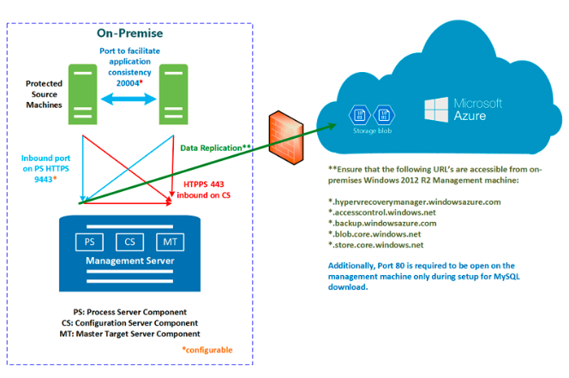
Graphical Representation

Slide 5
Configuration Steps:
Steps
Choose your protection goals
Set up the source environment
Set up the target environment
Set up replication settings
Capacity planning
Replicate applications
Test the deployment

Slide 6
Step1: Choose your protection goals

Slide 7
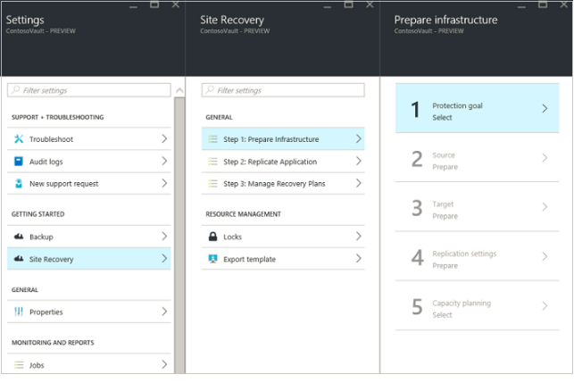
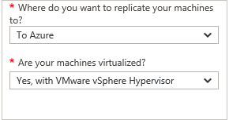
Step1: Choose your protection goals

Slide 8
Step 2: Set up the source environment

Slide 9
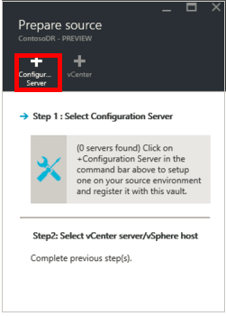
Step 2: Set up the source environment
On-premises :
Steps:
Choose Windows Server 2012 R2 to install configuration server .
Configure Proxy to access Service URLs
Download Azure Microsoft Site Recovery Unified Setup.
Download Vault Credentials
Run installation setup on selected server & use the vault registration key to register it with the vault
Run cspsconfigtool.exe to create one or more management accounts on the configuration server.

Slide 10
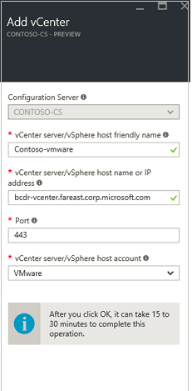
Step 2: Set up the source environment
If you want to Connect to vSphere hosts and vCenter servers
Note:
If you're adding the vCenter server or vSphere host with
an account that doesn't have administrator privileges on the
vCenter or host server, then make sure that the account has
these privileges enabled: Datacenter, Datastore, Folder, Host,
Network, Resource, Virtual machine, vSphere Distributed Switch.
In addition the vCenter server needs the Storage views privilege.

Slide 11
Step 3: Set up the target environment

Slide 12
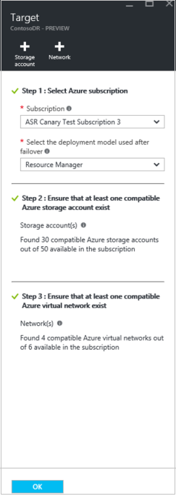
Step 3: Set up the target environment

Slide 13
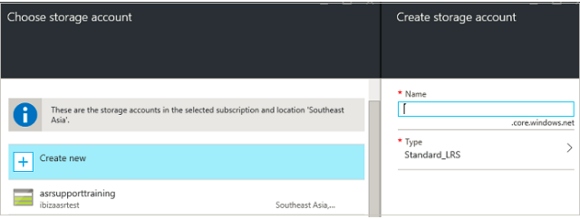
Step 3: Set up the target environment

Slide 14
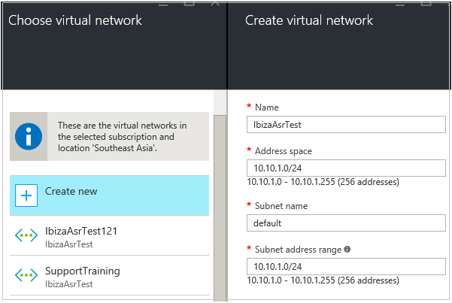
Step 3: Set up the target environment

Slide 15
Step 4: Set up replication settings

Slide 16
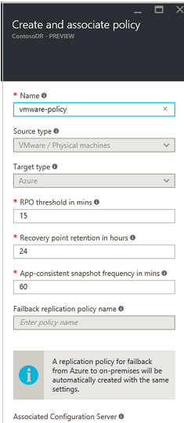
Step 4: Set up replication settings

Slide 17
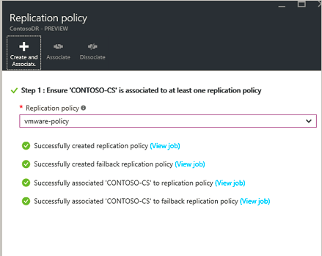
Step 4: Set up replication settings

Slide 18
Step 5: Capacity planning

Slide 19
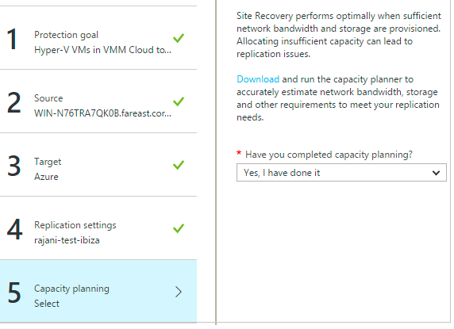
Step 5: Capacity planning

Slide 20
Step 6: Replicate applications

Slide 21
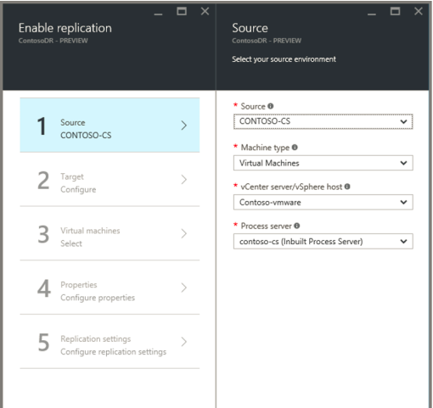
Step 6: Replicate applications

Slide 22
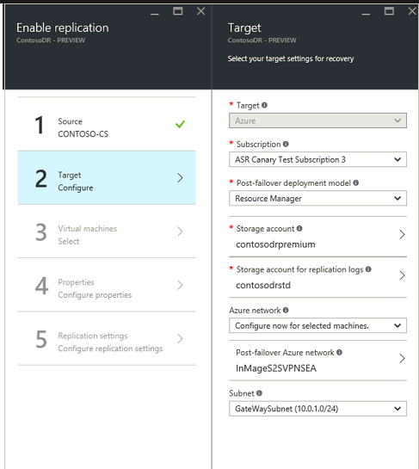
Step 6: Replicate applications

Slide 23
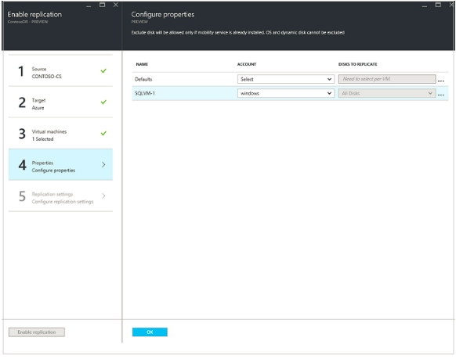
Step 6: Replicate applications

Slide 24
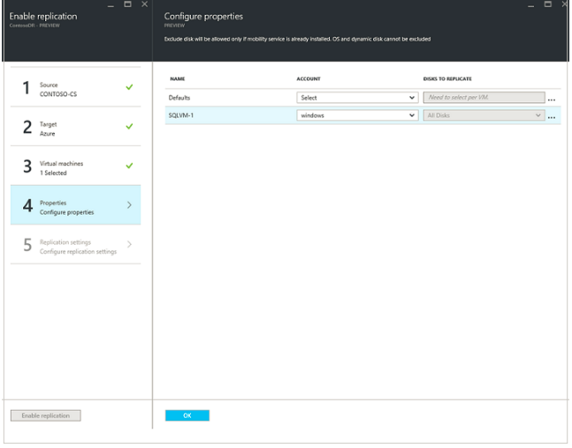
Step 6: Replicate applications

Slide 25
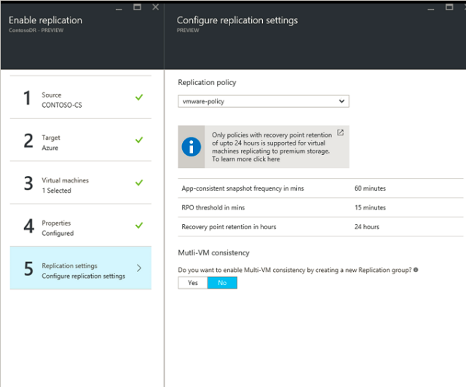
Step 6: Replicate applications

Slide 26
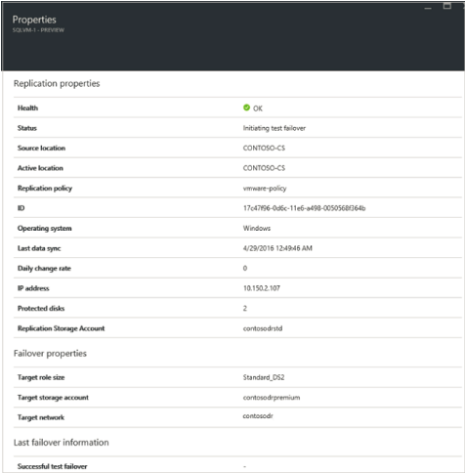
Step 6: Replicate applications

Slide 27
Step 7: Test the deployment

Slide 28
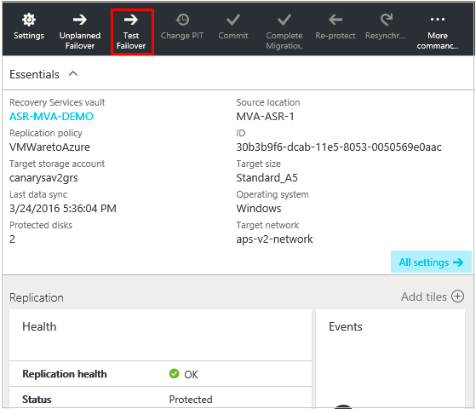
Step 7: Test the deployment

Slide 29
Replicate Hyper-V virtual machines in
VMM clouds to Azure

Slide 30
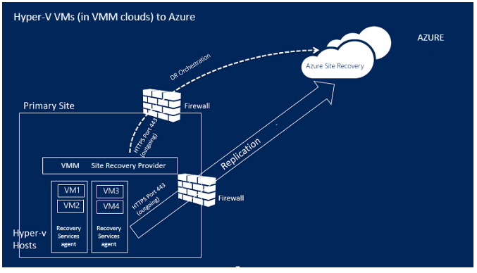
Graphical Representation

Slide 31
Configuration Steps:
Steps
Choose your protection goals
Set up the source environment
Set up the target environment
Set up replication settings
Capacity planning
Enable replication
Test your deployment

Slide 32
Step 1: Choose your protection goals

Slide 33
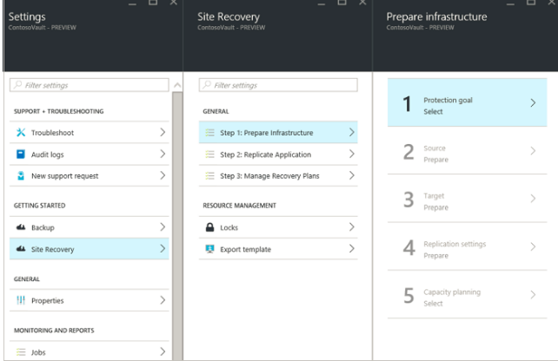
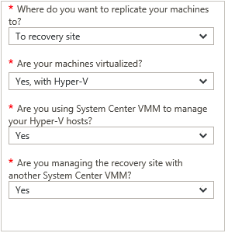
Step 1: Choose your protection goals

Slide 34
Step 2: Set up the source environment

Slide 35
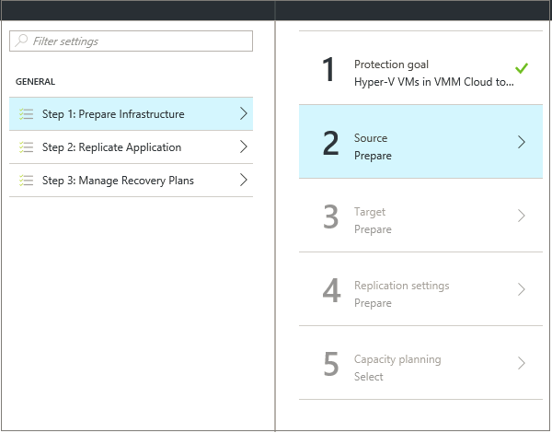
Step 2: Set up the source environment

Slide 36
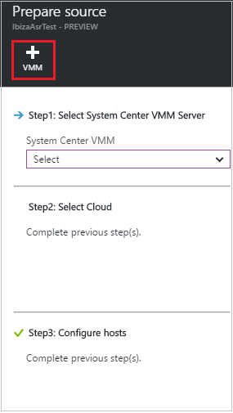
Step 2: Set up the source environment

Slide 37
Step 2: Set up the source environment
To Register your System Centre VMM server
Steps:
Check that the VMM server has at least one VMM cloud configured
Configure required proxy settings so that VMM service can access the Service URLs
Download the installer for the Microsoft Azure Site Recovery provider & download vault registration credentials
Install the Provider on the VMM server and use the registration key to register the server in the vault.
To Register your Windows Server 2012 R2 Hyper-V hosts
Steps:
Check that Hyper-V hosts are assigned to appropriate VMM cloud
Configure Proxy Settings so that Hyper-V host can access Service URLs
Download the installer for the Microsoft Azure Recovery Services agent
Run the installer on each Hyper-V server in the VMM cloud to install the agent.

Slide 38
Step 3: Set up the target environment

Slide 39
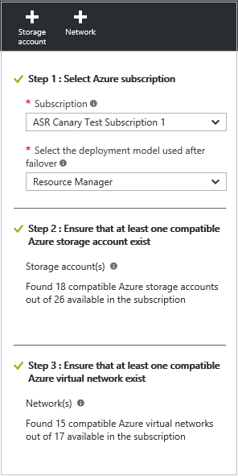
Step 3: Set up the target environment

Slide 40
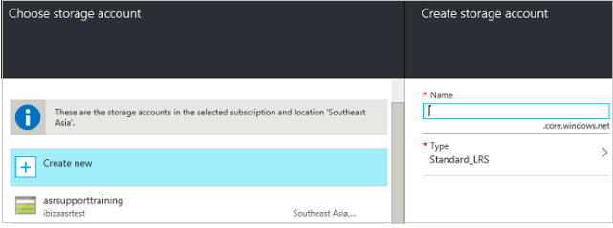
Step 3: Set up the target environment

Slide 41
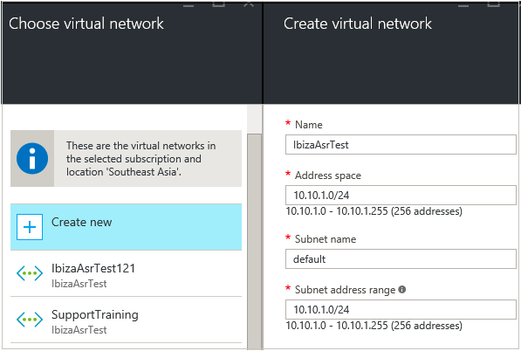
Step 3: Set up the target environment

Slide 42
Step 4: Set up replication settings

Slide 43
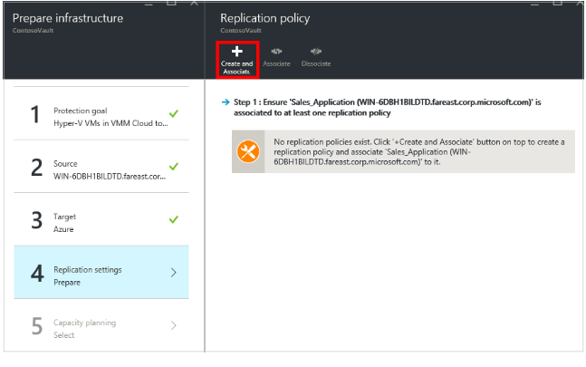
Step 4: Set up replication settings

Slide 44
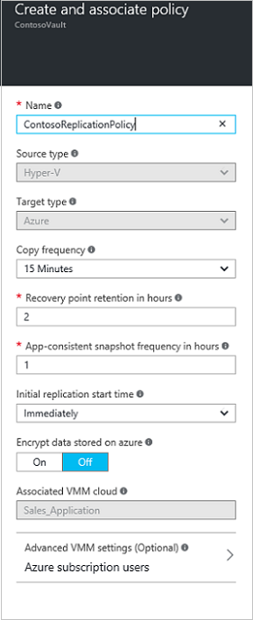
Step 4: Set up replication settings

Slide 45
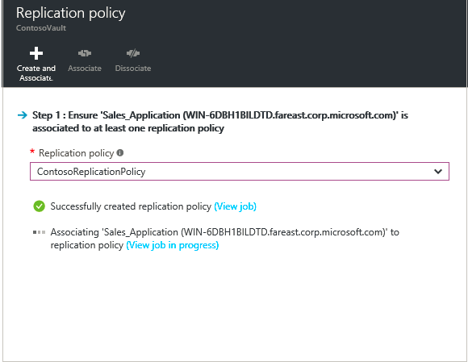
Step 4: Set up replication settings

Slide 46
Step 5: Capacity planning

Slide 47
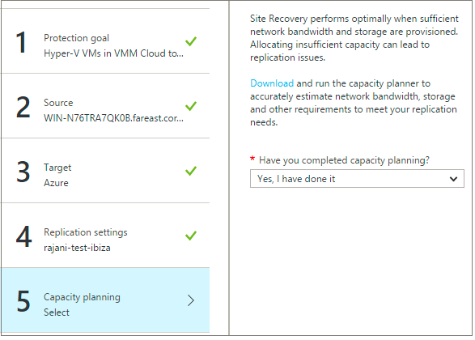
Step 5: Capacity planning

Slide 48
Step 6: Enable replication

Slide 49
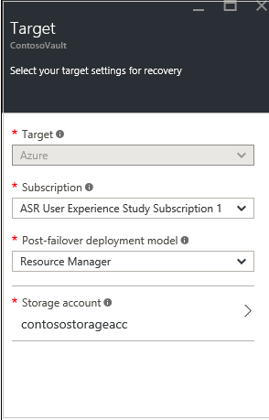
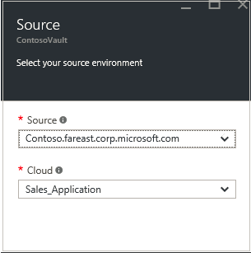
Step 6: Enable replication

Slide 50
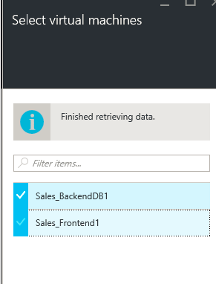
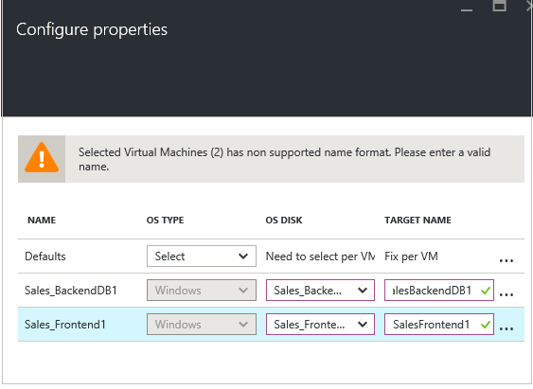
Step 6: Enable replication

Slide 51
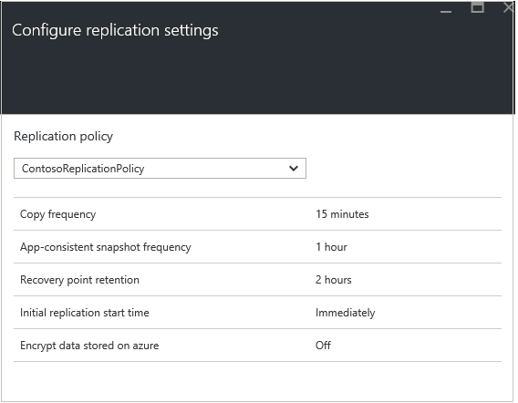
Step 6: Enable replication

Slide 52
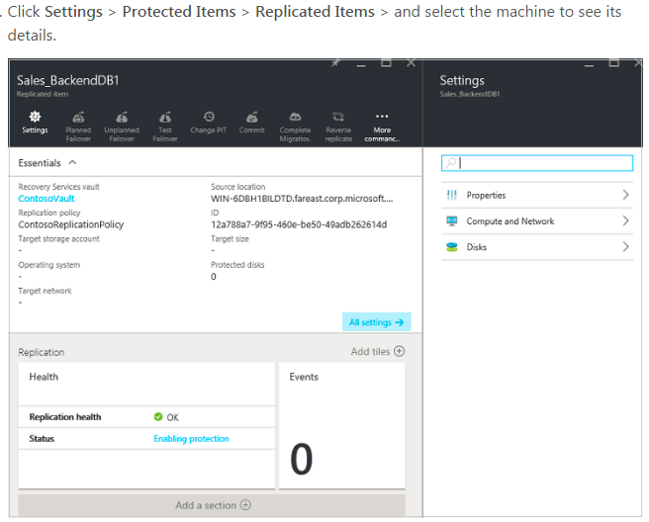
Step 6: Enable replication

Slide 53
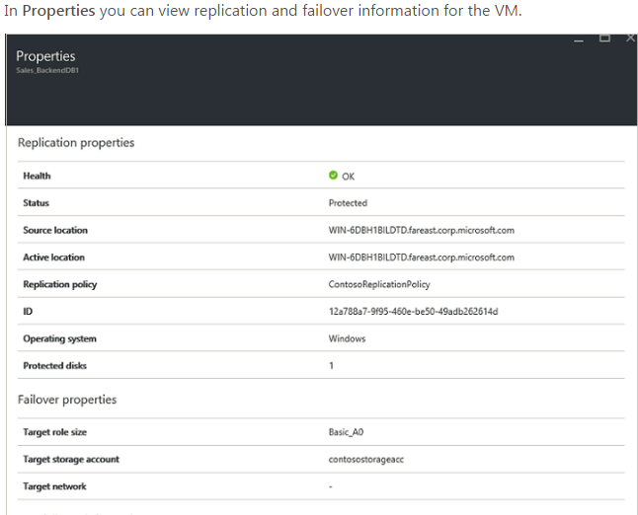
Step 6: Enable replication

Slide 54
Step 7: Test your deployment

Slide 55
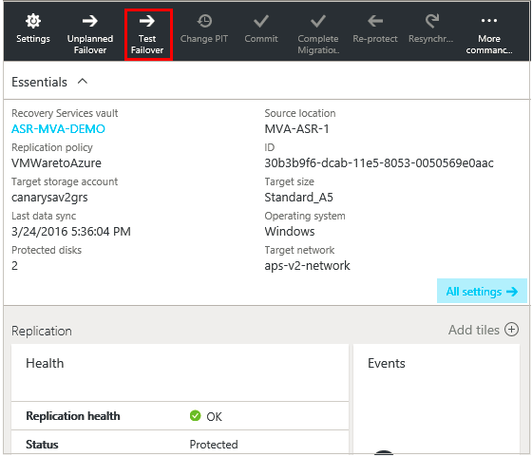
Step 7: Test your deployment

